Slide 1
Team 3 Presentation
Scalable AI infrastructure (Cosmic AI or CAI) tailored to Redshift Prediction
Bardia Nikpour (ddb4tr)
Victor Ontiveros (qfw3cr)

Slide 2
Project Overview
Objective
Develop a scalable, cost-effective, and accessible AI system that predicts redshift values from astronomical images using a foundation model deployed on cloud serverless infrastructure. Redshift estimation is crucial for understanding the distance of celestial objects and the expansion of the universe.
​
What we did?
We built a solution using AstroMAE, a masked autoencoder foundation model, deployed via AWS Lambda in a novel Cloud-based Astronomy Inference (CAI) architecture.

Slide 3
Project Details
Dataset and Domain
The dataset comprises 659,857 SDSS galaxy images, each 32×32×5 across five spectral bands . Data is stored in tensor format and partitioned for efficient cloud processing.
Data Structure & Preprocessing )
Preprocessing steps: Image normalization, magnitude extraction, partitioning (25MB–100MB).
Storage: AWS S3 for scalable data access.
Partitioning enabled horizontal scaling and efficient memory use.
Pipeline Architecture
The CAI pipeline includes:
Initialization: Determines job parameters.
Partitioning: Splits dataset for concurrent Lambda processing.
Inference: Executes model in parallel containers.
Aggregation: Collects results into final predictions.

Slide 4
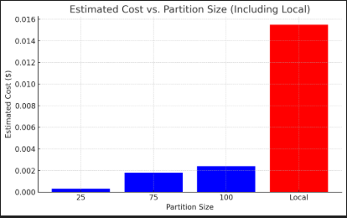
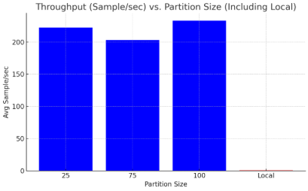
Project – Results Performance
All AWS Lambda partition sizes achieve high throughput, making them suitable for real-time or large-scale inference.
Local inference is not competitive, and 25MB provides the best speed-to-cost ratio.
The chart confirms that serverless inference using smaller partition sizes is dramatically more cost-effective, with 25MB offering the best cost-performance ratio — while Local inference is not viable at scale.

Slide 5
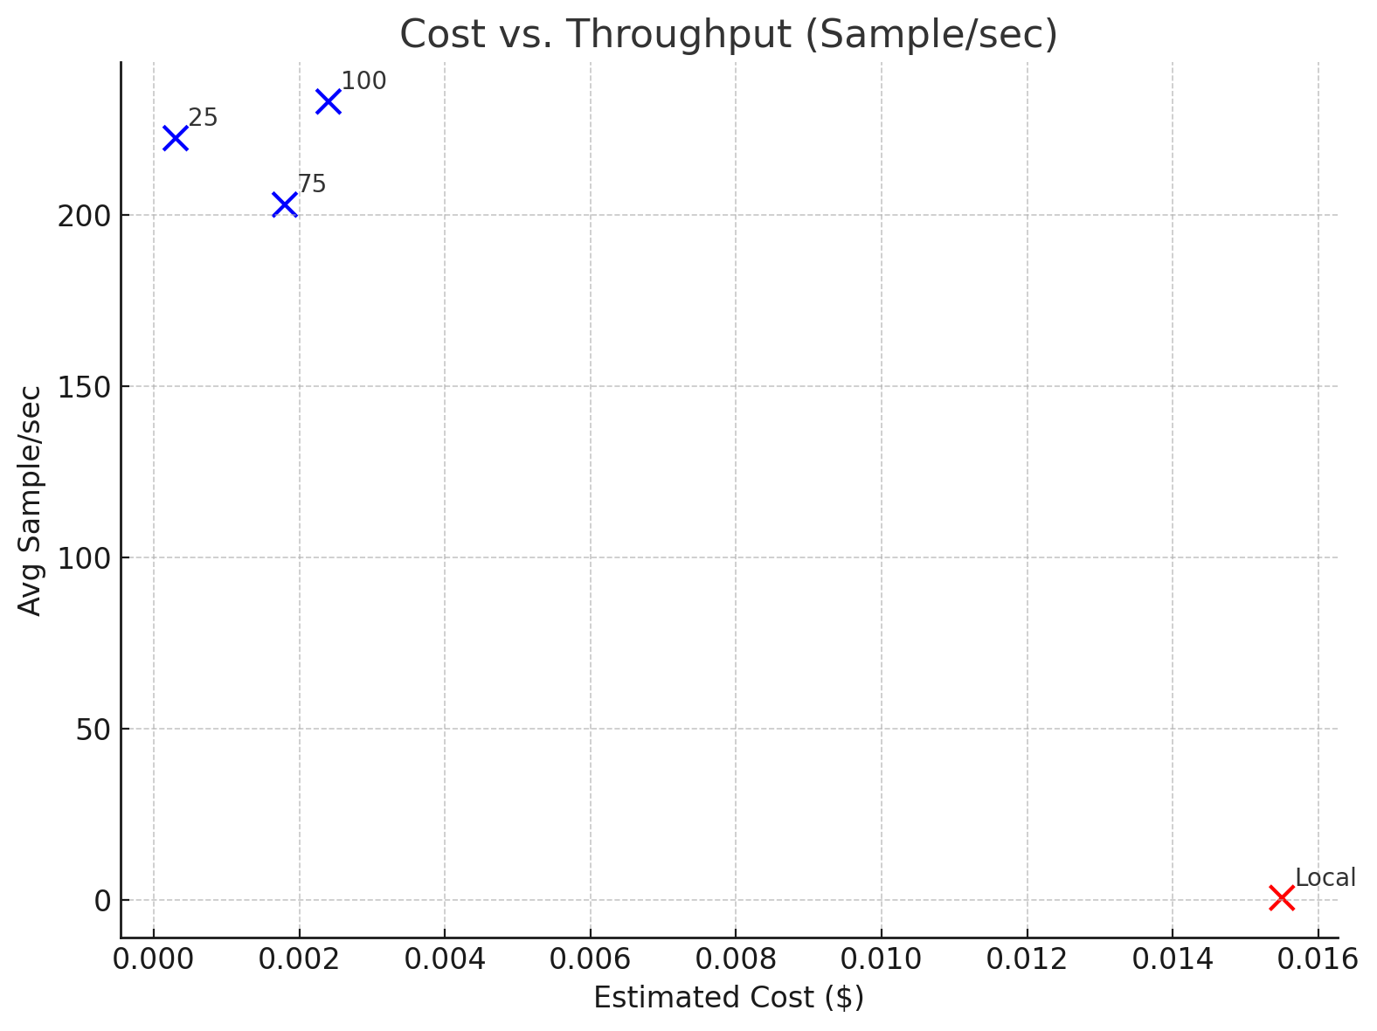
Project – Results Performance
This plot shows how each partition size affects the trade-off between inference throughput and total execution cost using AWS Lambda:
100MB partitions deliver the highest throughput (~233 samples/sec), making them ideal for latency-sensitive applications.
25MB partitions offer slightly lower throughput (~222 samples/sec) but at a significantly lower cost ($0.0003 vs $0.0024), representing the most cost-efficient configuration.
75MB sits in the middle with modest throughput (~203 samples/sec) and moderate cost.
🟩 Conclusion:
25MB partitions provide the best cost-performance balance, while 100MB partitions optimize for speed. The sweet spot depends on whether cost savings or maximum throughput is the goal.

Slide 6
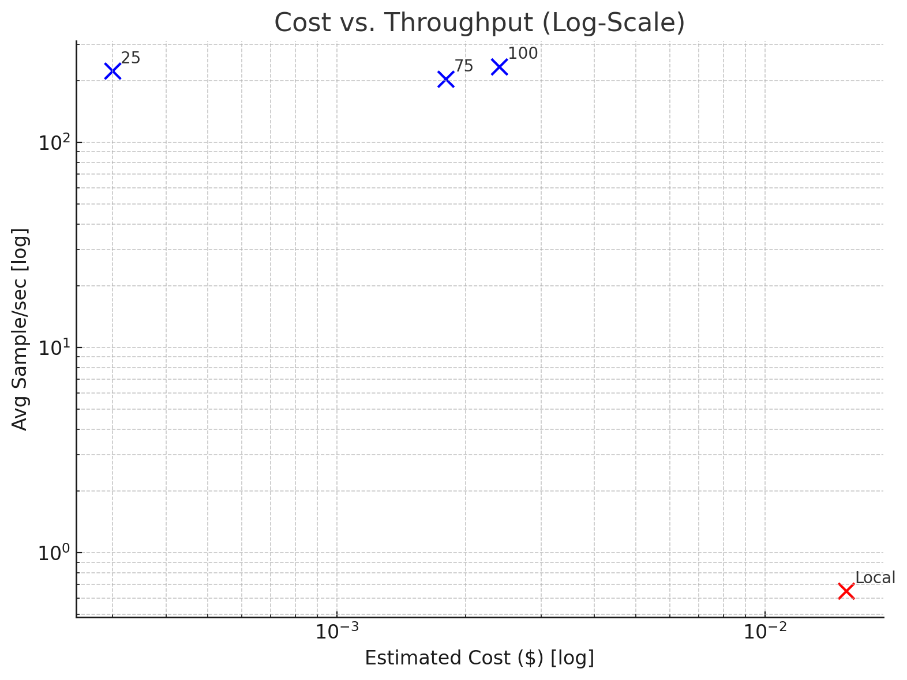
Project – Results Performance
In the log-log plot, throughput and cost differences are viewed on an exponential scale:
All AWS Lambda configurations fall in the upper-left quadrant, indicating both high efficiency and low cost.
25MB is closest to the optimal zone: lowest cost and high throughput, confirming its suitability for scaling.
100MB appears slightly farther right (higher cost), but slightly higher vertically (best throughput).
🟩 Conclusion:
On a logarithmic scale, AWS Lambda options remain highly efficient, with 25MB again emerging as the most cost-effective while still maintaining competitive performance.

Slide 7
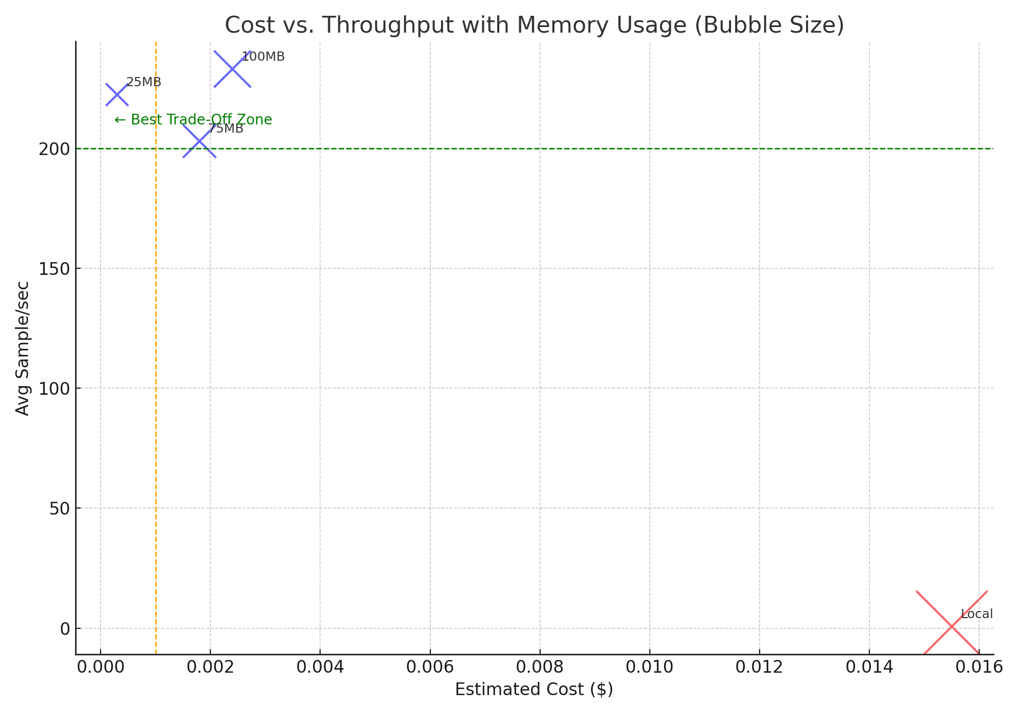
Project – Results Performance
🟩 Highlighted Zones:
Green dashed line: Throughput ≥ 200 samples/sec
Orange dashed line: Cost ≤ $0.001 ➤ Best trade-off zone is left of orange and above green
✅ 25MB clearly lands in the optimal cost-performance region. ❌ Local is the slowest and most memory-intensive, furthest from the optimal zone.

Slide 8
Project – Results Efficiency
Compared To | 25MB Is ___x More Efficient
75MB | 6.57×
100MB | 7.63×
Conclusion:
The 25MB Lambda configuration is 6.6–7.6× more efficient than larger partition sizes when comparing throughput per dollar spent.

Slide 9
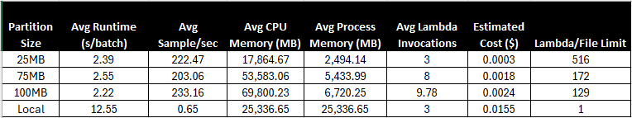
Project -Summary Results
Key Highlights
Parallelism scales with partition size
25MB: 516 Lambda invocations (max concurrency)
100MB: 129 Lambda invocations
Local inference is slow and costly
0.65 samples/sec at $0.0155 — not scalable
Best trade-off: 25MB partition
Excellent balance of speed, cost, and scalability
AWS runtimes are consistently fast
25MB partition is the most cost-effective
$0.0003/run → 7× cheaper than 100MB, 50× cheaper than Local
100MB partition has highest throughput
233.16 samples/sec (best performance)
25MB is close (222.47 samples/sec) at a fraction of the cost
2.2–2.5 sec/batch vs. Local: 12.55 sec/batch

